Slide 1

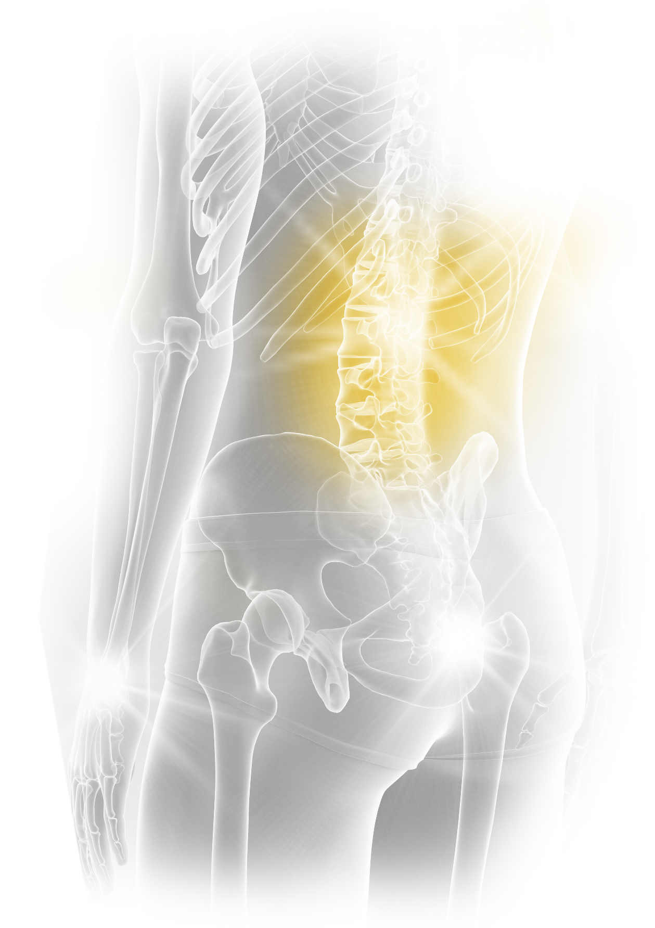
Take the next step
Stryker education
The Great Debate
EEMEA
25-26 October, 2023
Dubai, United Arab Emirates
Agenda
You specialise in your patients.
We specialise in you.

Slide 2
Take the next step
Stryker education
The Great Debate EEMEA
25-26 October 2023 – Dubai, UAE
1st Day: 25 October, Wednesday
For
Against
Duration | Subject | Speaker
08:00 – 08:20 | Welcome and introduction | Manuel Correa Dragana Bunjevac (TBC)
08:20 – 09:20 | Debate 1- 3D printed cages will get better fusion than PEEK cages | Slade Vermaak Abdul Baco
09:20 – 10:20 | Debate 2- We will not be able to live without Robotic and AI- Spine Surgery | Adrian Swan Harel Arzi
10:20 – 10:40 | Coffee Break
10:40 – 11:40 | Debate 3- Adult deformity surgery is a waste of time and money | Dmitry Ptashnikov Ian Zondagh
11:40 – 12:40 | Debate 4- MIS Fusion is less effective than traditional open procedures | Mariusz Glowacki Firas Husban
12:40 – 13:40 | Lunch
13:40 – 14:40 | Debate 5- When treating a L4/L5 degenerative Spondylolisthesis an interbody is always needed | Ian Vlok Saad Surur
14:40 – 15:40 | Debate 6- Expandable cages have a higher complication and revision rate than static | Çağatay Öztürk Wiktor Urbanski
15:40 – 16:00 | Coffee Break
16:00 - 16:40 | Keynote- Burnout on Spine Surgeons | Johan Davis
17:00 | End of Day 1

Slide 3
Take the next step
Stryker education
The Great Debate EEMEA
25-26 October 2023 – Dubai, UAE
2nd Day: 26 October, Thursday
For
Against
Duration | Subject | Speaker
08:20 | Start
08:20 – 09:20 | Debate 7- Sagittal balance is important for single level fusions | Andrey Bokov Mehmet Aydogan
09:20 – 10:20 | Debate 8- Prone Position lateral interbody fusion is better than lateral decubitus and posterior screws | TBC Basil Al Sharef
10:20 – 10:40 | Coffee Break
10:40 – 11:40 | Keynote- Dealing with colleague’s revisions | Jake Timothy
11:40 – 12:30 | Wrap Up Session/ Debate awards
12:30 | Lunch and Departures
Notes:
9 am start
Drop a debate- 11-11:30 coffee
Best debate award, Wrap up 30 min--- QR score for feedback--- Bassem for awards? Voucher for Books for department?
30 min keynote
Annalisa ppt template for TGD

Slide 4
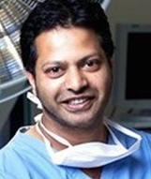
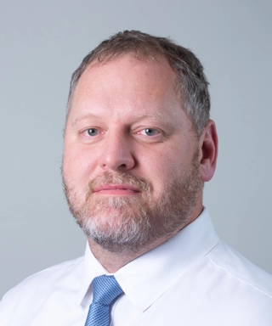
Take the next step
Stryker education
The Great Debate EEMEA
25-26 October 2023 – Dubai, UAE
Meeting Chairs
Mr. Jake Timothy
Leeds, United Kingdom
Dr. Johan Davis
Stellenbosch, South Africa
Contact Information:
Manuel Correa
Manager, Marketing, Spine, EEMEA
E: manuel.correa@stryker.com
Deniz Yonat
Medical Education Associate
E: deniz.yonat@stryker.com

