Slide 1

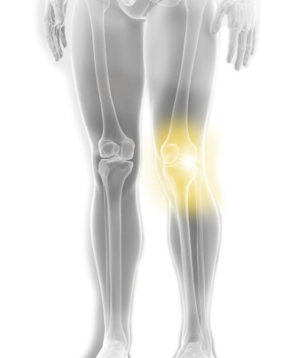

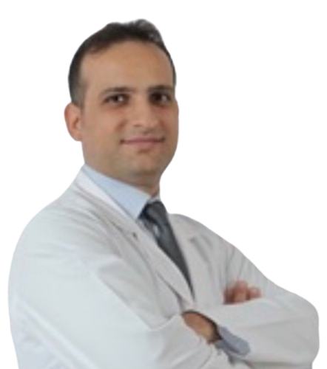
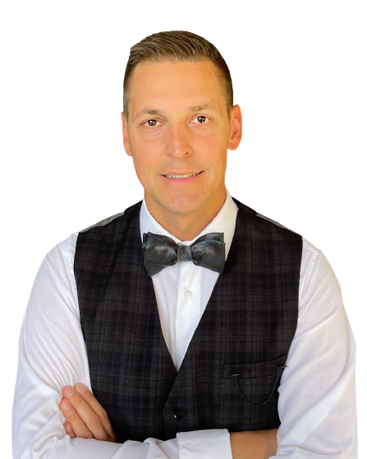
Take the next step
Stryker education
Stryker education
Stryker education
Triathlon Course
Agenda
25-26 April 2023
InSITE Center, Istanbul
Agenda
Faculty
Jacobus D. Jordaan
South Africa
Fatih Yıldız
Turkey
Nikolay Kornilov
Russia

Slide 2
Take the next step
Stryker education
EEMEA Primary Knee Course
25-26 April 2023, InSITE Center, Istanbul
Day 1: 25 April, Tuesday
09:00-09:30 | Registration
09:30-10:00 | InSITE Center surgical floor tour | Cem Sever
10:00-10:10 | Welcome & Introduction | Cem Sever
10:10-11:10 | History wall workshop | HCP Faculty + Stryker
11:10-11:30 | Replacing the native knee establishing 3, 2, 1 | HCP Faculty
11:30-11:50 | Coffee Break
11:50-12:10 | Surgical philosophies | HCP Faculty
12:10-12:30 | The Importance of the entry hole | HCP Faculty
12:30-13:00 | The Importance of joint line (How do you restore it and what are your considerations?) | HCP Faculty
13:00-13:20 | Posterior reference vs Anterior referencing (Which do you use and why?) | HCP Faculty
13:20-14:30 | Lunch Break
14:30-14:45 | The importance of tibial alignment and tibial slope | HCP Faculty
14:45-15:00 | Triathlon 6 key differentiators | Stryker
15:00-17:00 | Triathlon dry bones instrumentation workshop | All
17:00 | Day 1 Close
19:30 | Group Dinner
Day 2: 28 June, Tuesday

Slide 3
Take the next step
Stryker education
EEMEA Primary Knee Course
25-26 April 2023, InSITE Center, Istanbul
Day 2: 26 April, Wednesday
09:00-09:30 | Coffee and Welcome
09:30-11:30 | Dynamic Triathlon Cadaveric Lab Session Key Knee Surgical Steps The importance of the entry hole The importance of the joint line Posterior Reference vs Anterior Referencing The importance of tibial alignment/slope | HCP Faculty
11:30-11:45 | Coffee Break
11:45-12:00 | Triathlon clinical evidence | Stryker
12:00-12:35 | Pre-Op case discussions + Case studies | HCP Faculty
12:35-12:50 | Group feedback on knee replacements | HCP Faculty
12:50-13:00 | Meeting wrap-up and close | HCP Faculty + Cem Sever
13:00 | Lunch and Transfer/Departures
Day 2: 28 June, Tuesday

